Slide 1


High Performance Cluster Computing
Architectures and Systems
Hai Jin
Internet and Cluster Computing Center

Slide 2
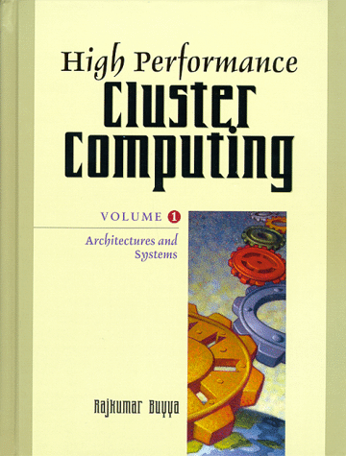
Distributed Shared Memory
Introduction
Data Consistency
Network Performance Issues
Other Design Issues
Conclusions

Slide 3
Introduction (I)
Loosely-coupled distributed systems
  message passing
  RPC
Tightly-coupled architectures (multi-processor)
  shared memory
  simple programming model
Shared memory gives transparent process-to-process communication, and easy programming
Distributed shared memory
  extended for use in more loosely-coupled architecture
  processes shares data transparently across node boundaries
  allow parallel programs to execute without modifications
  programs are shorter and easier than equivalent message-passing
  applications are slower than hand-coded message passing
  consistency maintenance problem

Slide 4
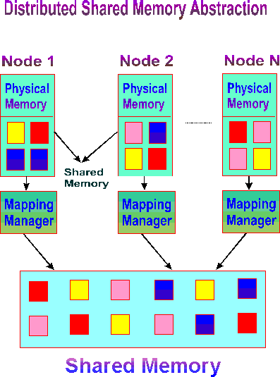
Distributed Shared Memory

Slide 5
What DSM can Contribute?
Automatic data distribution
  Data gets pulled where its need on demand
  Location transparency
Transparent coherence management
  Shared data automatically kept consistent
Can build fault tolerance and security

Slide 6
Introduction (II)
DSM vs. Message-Passing
  A well built message-passing implementation outperform shared-memory
  Relative costs of communication and computation are important factors
    In some cases, DSM can execute faster than message-passing

Slide 7
Introduction (III)
Main Issues of DSM
  Data Consistency
    Data Location
    Write Synchronization
    Double Faulting
    Relaxing Consistency
    Application/Type-specify Consistency
  Network Performance Issues
  Other Design Issues
    Synchronization
    Granularity
    Address-Space Structure
    Replacement Police
    Heterogeneity Support
    Fault Tolerance
    Memory Allocation
    Data Persistence

Slide 8
Data Consistency
Network latency
  caching and consistency algorithms
Three consistency model
  strict consistency - “sequential consistency” (Lemport)
  loosely consistency - synchronization points (compiler or user)
  no consistency - user-level synchronization and consistency
Many older DSM systems - strict consistency
  single writer/multiple reader model
    need one data locating node
    data is replicated on two or more nodes, none has write access
    two problem
      must locate a copy of the data when it is non-resident
      must synchronize accesses to the data, when writing at the same time
But the performance benefits of relaxing the consistency model

Slide 9
Data Consistency - Data Location
Assign an “owner” node to each item of data
The owner is allowed to write to the data
Ownership algorithm
  Fixed ownership
    each piece of data is assigned a fixed owner
    from the address of the data (ex. by hashing )
  Dynamic ownership
    Manager: not own the data, but track the current owner
    Centralized
      A node is selected as the “manager” for all the shared data
    Distributed
      spilt the ownership information among the nodes
      Broadcast
        faulting processors send a broadcast message to find the current owner of each data item
      Dynamic
        search “probable” owner of each data item
        in worst case, O(p+Klog p)

Slide 10
Homeless and Home-based Software DSMs
P1
P2
P3
P1
P2
P3
0
m-1
Cache
0
m-1
Cache
0
m-1
Cache
Cache
Cache
Cache
X RO
X INV
X RW
0
m-1
Home
m
2m-1
Home
2m
3m-1
Home
COMA architecture
The local memory of each machine is like a large cache. Shared pages are replicated and migrated dynamically according to sharing pattern
Example: TreadMarks
NUMA architecture
Each shared page has a home to which all writes are propagated and from which all copies are derived
JIAJIA takes home-based architecture

Slide 11
Memory Organization of Homeless Software DSM
P1
P2
P3
P4
0
m-1
Cache
0
m-1
Cache
0
m-1
Cache
0
m-1
Cache
X RW
X RW
X RO
X INV
A page may be cached by any processor, any processor may be the current owner of the page
No cache replacement mechanism is implemented (difficulty: the last copy problem), the shared space is limited by the memory of a single machine

Slide 12
Memory Organization of Home-based Software DSM
P1
P2
P3
P4
a
Home
a
Cache
a
Cache
Home
Home
Cache
Cache
Home
Cache
Cache
Home
Uniform page mapping => no address translation
Implements cache replacement => support large shared space

Slide 13
Data Consistency –
Write Synchronization
In maintaining a strictly-consistent data set
Write Broadcast (write-update)
  can broadcast writes
  too expensive to be used
  if there is not a low level broadcast primitive, it’s a problem
Invalidation (write invalidate)
  can invalidate all other copies before doing an update
  broadcasting is expensive (in large DSM system)
  use unicast or multicast rather than broadcast
    problem of location
  the manager site maintains a “copy-set”
  distributing the copy-set data
    invalidation are passed down the tree

Slide 14
Data Consistency - Double Faulting
Read & write fault: two network transactions
  one to obtain a read-only copy of the page
  a second to obtain write access to the page
    the page is transmitted twice over the network
Algorithms to solve double faulting problem
  Hot Potato
    all faults are treated as write faults
    the ownership and data are transferred on very fault
  Li
    transfer ownership on a read fault
    subsequent write fault may be handled locally
  Shrewd
    a sequence number per copy of a page
    use to track where a page has been updated
    don’t eliminate the extra network transactions
The crucial factor appears to be the read-to-write ratio of the application

Slide 15
Data Consistency –
Relaxing Consistency (I)
Permitting temporary inconsistencies = increasing performance
Memory is “loosely consistent”
  If the value returned by a read operation is the value written by an update operation to the same object that “could” have immediately preceded the read operation in some legal schedule of the threads in execution
  More than one thread may have write access to the same object, provided that the programmer knows that the writes will not conflict
Delayed updates
  virtual synchrony - message operations appear to be synchronous
  semantic knowledge - when it is needed to access or update?
  compromise the shared memory concept & increase complexity

Slide 16
Data Consistency –
Relaxing Consistency (II)
Release Consistency
  ordinary & synchronization-related accesses (acquire, release)
  the “acquire” operation signals that shared data is needed
  a processor’s updates after an “acquire” are not guaranteed to be performed at other nodes until a “release” is performed
P1
P2
P3

Slide 17
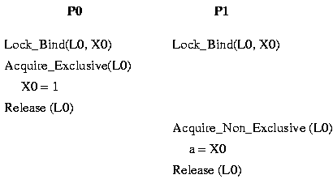
Data Consistency –
Relaxing Consistency (III)
Entry Consistency
  in a DSM system called Midway
  weaker than other models
  it requires explicit annotations to associate synchronization object with data
  on an “acquire”, only the data associated with the synchronization object is guaranteed to be consistent

Slide 18
Data Consistency –
Relaxing Consistency (IV)
P1
x=1
Acq(l1)
y=1
Rel(l1)
P2
Acq(l1)
a=x
b=y
Rel(l1)
Acq(l2)
z=1
Rel(l2)
P3
Acq(l2)
a=x
b=y
c=z
Rel(l2)
P1
x=1
Acq(l1)
y=1
Rel(l1)
P2
Acq(l1)
a=x
b=y
Rel(l1)
Acq(l2)
z=1
Rel(l2)
P3
Acq(l2)
a=x
b=y
c=z
Rel(l2)
Results：P2: a=b=1; P3:a=b=c=1
Results：P2: a=0,b=1; P3:a=b=0,c=1
Release Consistency
Scope Consistency

Slide 19
Data Consistency - Application/Type-specific Consistency (I)
Problem-oriented shared memory
  implement fetch and store operations specialized to the particular problem or application
  provide a specialized form of consistency and consistency maintenance that exploits application-specific semantics
  types of objects
    synchronization: lock objects, managed using distributed lock system
    private: not managed by the runtime, but brought back under the control of DSM if referenced remotely
    write-once: initialized once and then only read, so may be efficiently replicated
    result: not read until fully updated, use the delayed-updated mechanism to maximum benefit
    producer consumer: written by one thread, read by a fixed set of threads
      perform “eager object movement”, update are transmitted to the reader before they request them

Slide 20
Data Consistency - Application/Type-specific Consistency (II)
Problem-oriented shared memory
  types of objects
    migratory: accessed by a single thread at a time, integrating the movement of the object with the movement of the lock associated with the object
    write-many: written by many different nodes at the same time, sometimes without being read in between, handled using delayed updates
    read-mostly: updated rarely using broadcasting
    general read-write: multiple threads are reading and writing, or no hint of object type is given
  30% performance improvement is obtained
Programmer’s control
  open implementation (meta-protocol)

Slide 21
Network Performance Issues
Communication latency and bandwidth are so bad that affect design decisions of DSM system
  Much larger than a multi-processor
  Consistency and cache management (ex, data invalidation)
Recent advance in network
  ATM, SONET, switching technology
  Bandwidth are available over 1 Gbps even over wide-area network
  Processor speeds is increasing
  Latency is still higher than tightly-coupled architecture
  Key factor is the computation-to-communication ratio
    high ratios are suitable to message-passing mechanism
    analogues to the “memory wall”

Slide 22
Other Design Issues - Synchronization
It orders and controls accesses to shared data before actually accessing the data
Clouds merges locking with the cache consistency protocol
IVY - synchronization primitive (eventcounts)
Mermaid - P and V operations and events
Munin provides a distributed lock mechanism using “proxy objects” to reduce network load
Anderson - locking using an Ethernet-style back-off algorithm (instead of spin and wait locks)
Goodman - propose a set of efficient primitive to DSM case

Slide 23
Other Design Issues - Granularity
When caching objects in local memory
  Use fixed block size
The choice of the block size
  Cost of communication
  The locality of reference in the application
  False sharing or Ping-ping effect
Virtual-memory management unit or multiple thereof
The lowest common multiple of hardware-supported page size in heterogeneous machines
Memnet - fixed small granularity (chunk = 32byte)
  similar to shared memory multiprocessor system
Mether - a software implementation of Memnet on top of SunOS
  8K page size

Slide 24
Other Design Issues –
Address-Space Structure
The arrival of 64-bit processors ⇒ single shared address-space systems (single level store)
  The system appears as a set of threads executing in a single shared distributed address space
  Data items always appear at the same addresses on all nodes
  A private and a shared region
  Security and protection are a major problem
Separate Shared Address Spaces
  Divide each process’s address space into different fixed regions
  Cloud - O (shared), P(local/user), K(local/kernel)
  Objects always appear at the same address, but may not be visible from every address space
Shared-Region Organization
  How the shared region itself is organized?
  Some DSM (IVY, Mether) use a single flat region
  Most of DSM use paged segmentation
    The shared region consists of disjoint pieces that usually managed separately

Slide 25
Other Design Issues - Replacement Policy and Secondary Storage
A policy to deal with cache overflow
LRU does not work well without modification
  invalidated page
  read-only page
  replicated page
  writable page/pages don’t have replicas
(Markatos, Dramitinos) use of main memory in other nodes to store pages
(Memnet) reserve part of main memory of each node as storage for chunk
(IVY) piggybacking memory-state information on other network message
(Feeley) use of global memory for file buffer caching, VM for applications, and transactions

Slide 26
Other Design Issues - Heterogeneity Support
Attempts to provide support for heterogeneous systems
  Mermaid, CMU’s Mach system, DiSOM
Page-based Heterogeneity
  support for different page sizes without considering the data of pages
    Mach: use scheduler page size unit
    It’s not as simple as it sounds
  real heterogeneous-data support (byte-order, word-size)
    Endian problem, word size
    CMU DSM divide this problem to hardware data-type and software-type
Language-assisted Heterogeneity
  DiSOM, object-oriented and operates at the language level
    the application programmer should provide customized packing and unpacking routines for heterogeneity (marshalling)
  Gokhale and Minnich, packing at compile time
    load/store is 2-6 times slower

Slide 27
Other Design Issues –
Fault Tolerance
Most of DSM ignore the fault tolerance issue
DSM system would strongly effect the fault tolerance of a system.
  N systems are sharing access to a set of data, the failure of any one of them could lead to the failure of all the connected sites
How do you handle a failed page-fault?
  Clouds: a transactional system called Invocation-Based Concurrency Control (IBCC) using commit
  Wu and Fuchs: incremental checkpointing system based on a twin-page disk storage management system
  Ouyang and Heiser: two-phase commit protocol
  DiSOM: checkpoint-based failure recovery
  Casper: shadow paging

Slide 28
Other Design Issues –
Memory Allocation
The same piece of shared memory must not be allocated more than once
Amber allocates large chunks of the shared address space to each site at startup, and has an address-space server that hands out more memory on demand

Slide 29
Other Design Issues –
Data Persistence
DSM support some form of secondary storage persistence for data held in shared memory
It’s not easy to obtain a globally-consistent snapshot of the data on secondary storage because of the distributed data
Overlap between DSM and database system
Garbage collection: global garbage collection
Naming and location issues

Slide 30
Conclusions
A useful extra service for a distributed system
Provide a simple programming model for a wide range of parallel processing problems
Advantages
  no explicit communication is necessary
  may be made of locality of reference
Disadvantages
  handling of security and protection issues are unclear
  fault tolerance may be more difficult to achieve
Choosing between DSM and message-passing is quite difficult
  Forin: “the amount of data exchanged between synchronization points is the main indicator to consider when deciding between the use of distributed shared memory and message passing in a parallel application”

Slide 31
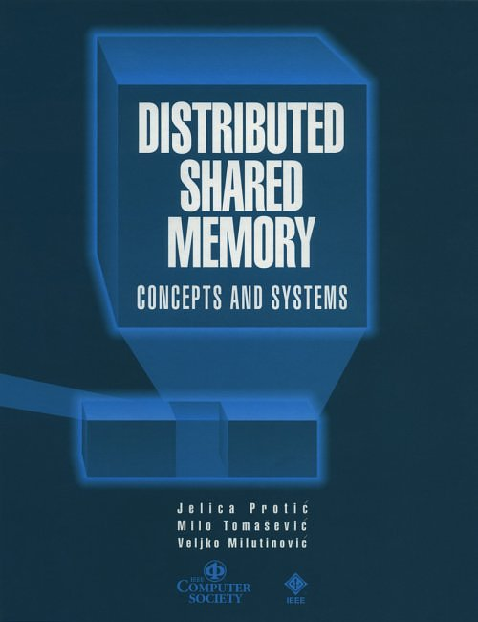
Reference Book

